Slide 1
Stocks that always trade choppy (or poorly) or just don’t like me
….so avoid them!!!
GILD
WMT
SNAP (doesn’t move much and is erratic)

Slide 2
Disaster Recovery Page
DAS Phone 1-702-943-1881 or 1-845-282-7859
Account: IBXXXXX
IB Phone 1-877-745-4222 or 1-514-847-3299
Account#: UXXXXXXXX
lD: XXXXXXXXXXXXX
pwd: XXXXXXXXXXXX

Slide 3
Acronyms
TTDT Take The Damn Trade
RIWT Right Idea, Wrong Timing
FILG F&&& It, Let’s Go

Slide 4
Trading RE-MIX – IMPORTANT!
The trend is my friend. I know this. I have to use the trend to get great trades and STOP passing on trades where I miss the beginning of a move. Stop being so proud that I will not enter a move once it’s started. I have watched too many moves that go for $1++ when I could have entered $0.10 or $0.20 late. Acknowledge the increased risk (and decreased r:r) and take a reasonable trade and stop just sitting on the sidelines and watching these moves pass me by.
STOP BEING SO PROUD, KEEP WATCHING, AND ENTER WHEN THE MOVE MAKES SENSE EVEN IF I AM A LITTLE LATE ON THE ENTRY.
“Don’t let perfect get in the way of better.” I have to focus on still taking an Andrew trade, even when I miss the initial entry. They are often awesome trades, even from my entry point. Just set my risk appropriately!
This is about making money and not about being right. Put aside my pride on nailing the entry perfectly and play smart moves that will make profitable trades.

Slide 5
Key Lessons:
PULL THE TRIGGER. You can’t win if you don’t play.
  Most of the trades I don’t make would be winners- SO MAKE THEM!
ON EVERY TRADE, identify entry, exit, & stop loss
  Stick to your plan. Don’t panic; follow the rules
WATCH THE STOCKS YOU’RE WATCHING. DO NOT get distracted and miss trades.
IGNORE your daily P&L. FOCUS solely on the trade your in, NOT on a number you want to achieve…or maintain!
If feeling uncertain, trade fewer shares (to minimize risk and allow me to mentally play the rules) but DO NOT sit on the sidelines
If moving against the news, trade with caution
If trading far from the VWAP (i.e. the stock is extended), trade with caution
If trading against the day trend, trade with caution
DO NOT try and time the tops and bottoms. Play the odds…and the meat of a move.
DO NOT DOUBLE-DOWN ON A LOSER
DO NOT trade the opening 5 min
DO NOT chase a trade. If you miss the entry, and the trade is no longer in a strong risk-reward ratio. DO NOT chase it.
PATIENCE is a virtue. Let a winner run once I scale back. ALWAYS be willing to risk all profit on final ¼ of shares for bigger gains. (And, if you have a great entry on a fast moving stock, let more run!)
If your “GUT” contradicts the technicals, DON’T TAKE THE TRADE. If your “GUT” says a direction and the technicals support it, TAKE THE TRADE.

Slide 6
Trade Rules:
Assess maximum risk, determine trade size
Don’t panic. Be rational and understand your entry, even on the open.
Avoid low-floats. You do not trade them well. (Maybe later as an advanced skill)
Enter a trade on:
    Opening range (momentum) breakouts
    VWAP breakthru or bounce
    Bull or bear flag
    ABCD pattern
    Top & Bottom Reversal
    STRONG(!) moving average support
    Red-to-green (previous close crossing)
While in a trade CONTINUALLY RE-ASSESS the conditions of the trade and adjust as required
Sell options:
    ½ at 2x max risk (or targeted support line above 2x- if moving!) + ¼ at next level +final ¼ at reversal or entry
    ½ at 2x max risk (or targeted support line above 2x- if moving!) + ½ at b/e FOR THE TRADE
    Full trade at max loss
    NEVER sell on a quick spike against you. Risk a further move and wait for it (it usually goes back).
As you exit a trade (win or lose), look for the REVERSAL PLAY!
DO NOT CHASE A STOCK. If you miss the entry, look for the next setup. DON’T CHASE.

Slide 7
How to play:
Any trend continuation, MA support/bounce, PCL break, VWAP break
  Step back from the trade and try to see the bigger move (big picture).
    If the big pictures supports your direction, take the trade. If not, don’t.
  Wait for a pullback and try to get in at the farthest reach of the pullback
    This should be generally at, or just before, a MA or support level
    Yes, this means you are entering as it was moving in the opposite direction (on the micro time frame), but still in the direction of the bigger move. Try and get this as it is reversing from the pullback back to the direction of the bigger move
  DO NOT use as support the 9 MA on the 1 or 2min chart, or the 20 MA on the 1min chart, unless it’s already a very proven (long trend) support.
    Generally these are too close to the action to actually signal moves.
Double tops and bottoms
  Let the double top/bottom clearly set up.
    Do not take the trade if the 2nd hasn’t yet reversed or if the set-up is weak (shallow pullback, just leaking, etc)
  Target an entry at as quick as possible, keeping in mind the MAs.
    If an MA is in the way, way for the price to cross before entering
  Stop is always just above the double top/bottom
Do not take VWAP trades just because they are at VWAP
  This chops me up more than anything else. Step back and see the bigger picture.
  The VWAP must support another pattern (see above).
WATCH THE STOCKS YOU’RE WATCHING. DO NOT get distracted and miss trades.
If your “GUT” contradicts the technicals, DON’T TAKE THE TRADE. If your “GUT” says a direction and the technicals support it, TAKE THE TRADE.

Slide 8
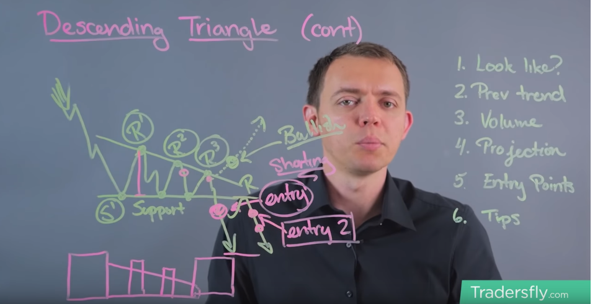
How to play:
(Decending) Triangles
  Can play the breakout bearish (default approach) or bullish (reversal) depending on how the breakout occurs.
  Ascending triangles are simply the opposite

Slide 9
Other strategies:
Pre-market gappers
  When a stock gaps by at least 20%, has volume >1M, and is trending above the VWAP, look at it for a long from about 7:30am.
  Stop-loss is VWAP, target is ???. Trades from the VWAP are great and can give awesome r:r
  Always sell before the market opens and watch carefully around 9am (until 9:25) as there is usually a pullback.
200%+ low float gainers
  When a stock shoots up 200%+ in regular trading on some news, the stock will often shoot up after market, even if it has dropped during the day.
  The best pattern is when it shoots up, retraces some of the gains then flatlines for the last hour or two into the close.
  Buy right before the close and hold for a few hours (until ~6pm) or even overnight
IPOs
  Only buy on the following conditions:
    Open price is above the IPO strike price
    >1M shares traded in the 1st 2min
    Price sets a new high, then retraces (ideally no more than ~20%). This new high is your entry price.
  Buy after the 1st 5min when/if(!!) it hits a newer high over the entry price
  Higher risk option: if the stock does not hit a new higher high after 5min but keeps going down, watch for the bottom and buy in on the reversal. Stop-loss will be the low of the day. 1st target would be VWAP, 2nd HOD, 3rd ???

Slide 10
Other strategies:
Choppy afternoons
  When there is a lot of chop, the better risk is to wait for a pullback to the top/bottom of the chop range before entering
  Never chase in chop. It’s a sure way to get stopped out
…
  …

Slide 11
Apr 8-12
Monday
Tuesday
Wednesday
Thursday
Friday
Live Trading
if (-$50) -> $200
if < (-$50)
Live Trading
SIM Trading D1
if (-$50) -> $200
if < (-$50)
Live Trading
SIM Trading D1
SIM Trading D2
if (-$100) -> $200
if < (-$100)
if > $50 x 2
if < $50 x 2
Live Trading
SIM Trading D1
SIM Trading D2
Live Trading
SIM Trading D3
if (-$100) -> $200
if < (-$100)
if > $50 x 2
if (-$50) -> $200
if < (-$50)
if > $50 x 2
if < $50 x 2
if < $50 x 2
Live Trading
SIM Trading D1
SIM Trading D2
Live Trading
SIM Trading D3
Live Trading
SIM Trading D1
Live Trading
SIM Trading D4

Slide 12
Tue, June 4th
Missed trades:
BOX short $5 stopped
FB short $20
AMD long $30
UBER long $50
FB short $29 stopped
BOX short $20 stopped
FB short $46
AMD short -$20 stopped
$180
3 / 3
None of my trades worked out today. I’m still not taking the trades I should. Not all will work, but I need to be in it to see if it can work.
(new review June 8th) $FB – it was a wonderful idea, poorly executed. Seems like I chased the entry which had me with too tight a stop for the conditions. This resulted in a shall gain that could have been huge as the stock moved $4!
Sample only
Today’s targets
Per trade risk: $ 20
Profit target: $100
Daily stop-loss: -$200
Mental state: Good
Trading effectiveness: TTDT

Slide 13
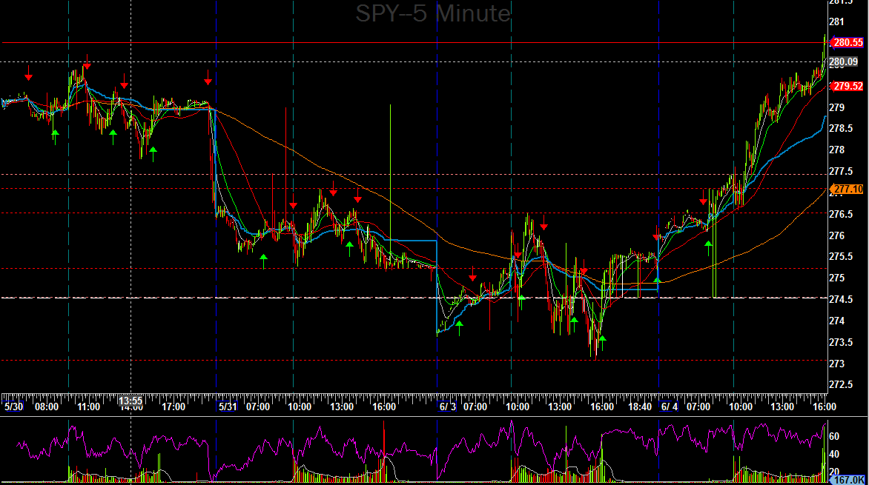
Tue, June 4th
Sample only

Slide 14
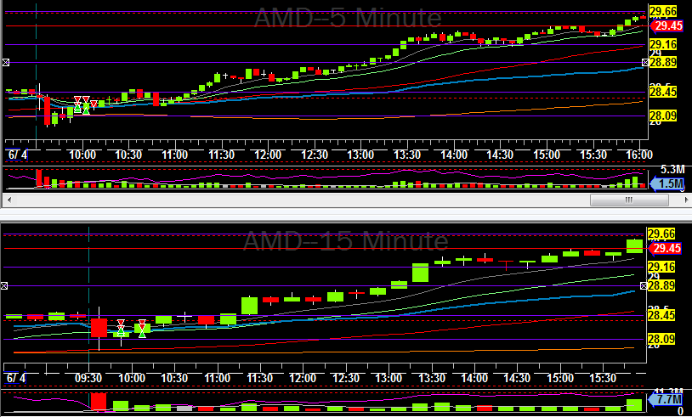
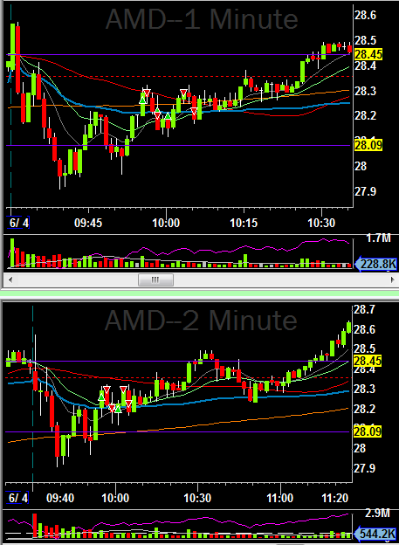
Tue, June 4th
1l– 300
-$34
2l– 200
$50
Sample only
1) Risk: 0.10
Pattern: VWAP break
Entry: Too early. I should have waited.
Exit: at target
Notes: The entry was too early, but I’m ok with how I managed it.
2) Risk: 0.10
Pattern: VWAP break
Entry: This was the better entry.
Exit: Too early. I was affected by the 1st loss. I should have waited…or even added below VWAP
Notes: This could have been the best trade of the day.

Slide 15
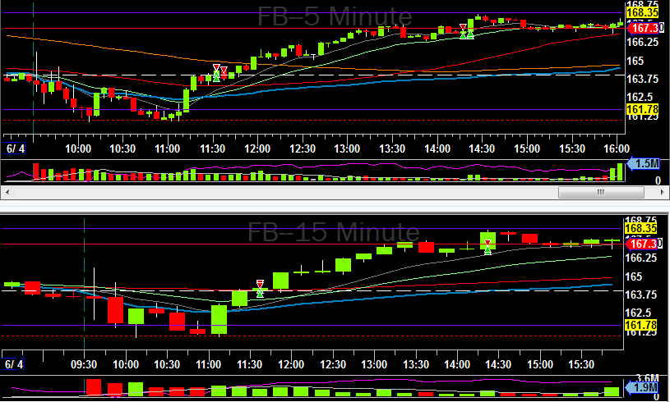
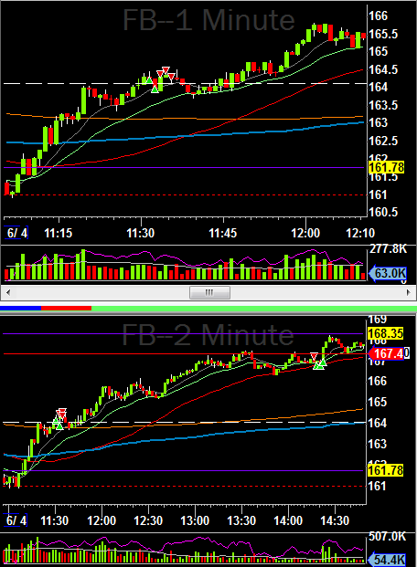
Tue, June 4th
3l– 100
$92
Sample only
4s– 100
$43
3) Risk: 0.20
Pattern: PCL break
Entry: 1st too early, 2nd better / Exit: Ok. Move didn’t continue
Notes: Good idea, just didn’t work out. I could have considered re-entry at the 20MA.
4) Risk: 0.20
Pattern: Dbl top
Entry: Good
Exit: Ok. Move didn’t continue.
Notes: This was another ok trade that didn’t work.

Slide 16
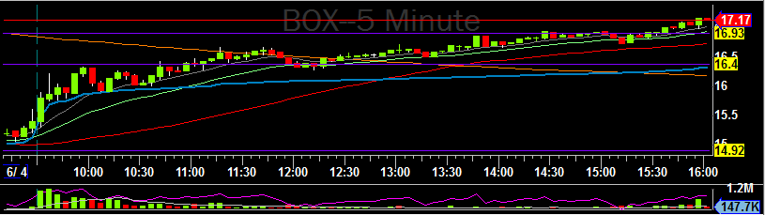
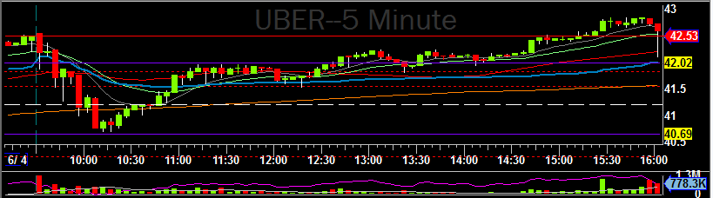
Tue, June 4th - Trades I should have taken!
Sample only

Slide 17
Templates

Slide 18
THIS IS AWESOME
THIS IS TRICKY
THIS IS CRAP
I AM CRAP
THIS MIGHT BE OKAY
THIS IS AWESOME
(repeat)
The Trading Process

Slide 19
Trade
TTDT
Damn
The
Take

Slide 20
Xxx, xxx xx
Missed trades:
XX short $xx
$0
x / x
note
Today’s targets
Per trade risk: $ 100
Profit target: $500
Daily stop-loss: -$300
Mental state: None
Trading effectiveness: None

Slide 21
XXX, XXX XX
Trade notes
Day Notes
Comments

Slide 22
Psychology

