Slide 1
Camarilla Pivot System
Part 1
First Principles of Market Mechanics
Gary Lunia

Slide 3



Framework for Camarilla Pivots
Concept 1
(The What?)
Value vs Price
Concept 2
(The Why?)
Greed vs Fear
Concept 3
(The How?)
Markets & Auction

Slide 4
What is Value, What is price?
Concept | What It Is | Nature | Driven By
Price | The explicit amount of money required to purchase an item. | Objective & Static: It is a hard number on a price tag. | Market forces, production costs, and supply/demand.
Value | The perceived worth, usefulness, or long-term benefit of that item. | Subjective & Dynamic: It changes depending on who is buying and when. | Utility, emotional attachment, scarcity, and problem-solving ability.
Value is Elusive, Price is the only constant!

Slide 5
Value vs Price
Sell
If price of an object is lower than the value you assign to it, you are willing to buy
Conversely, if price of an object is higher than the value you assign, you are willing to sell
Since Value is elusive, and can change person to person, price is the only truth.
Price is a concrete mathematical event, while Value is a psychological consensus.
Market opportunity only exists when temporary emotional panic forces Price to disconnect from structural Value.
Perceived Value
Buy

Slide 6

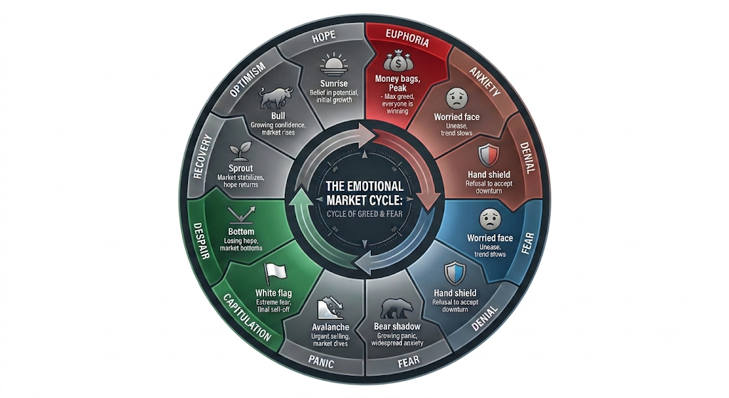
Why are Greed and Fear repeatable patterns

Slide 7
The Anatomy of Greed & Fear
1. The Principle of Reflexivity (The Feedback Loop)
Price changes behavior, and behavior changes price." — George Soros
The Greed Loop: When price goes up, it triggers a chemical response in traders (and validation parameters in algorithms). Seeing others make money creates FOMO (Fear of Missing Out). Buyers rush in, which pushes the price even higher. The higher price validates the greed, attracting more buyers. Price completely detaches from structural value.
The Fear Loop: The exact inverse happens on the way down. Price drops, creating anxiety. To protect capital, traders sell. That selling drives the price lower, triggering automated stop-losses and margin calls, forcing more selling.

Slide 8
Structural Exhaustion
3. The Structural Exhaustion Points
Why doesn't greed go up forever, or fear drop to zero? Because of liquidity exhaustion in the order book.
.
The Top For a market to keep rising, it requires a continuous influx of aggressive buyers willing to pay higher and higher prices. Eventually, the market runs out of "greater fools." The order book thins out at the highs. A single large sell order can then tip the scale, sending a shockwave through the over-leveraged buyers
The Bottom: Panic eventually forces everyone who is weak-handed, over-leveraged, or terrified to sell. Once the final panic-seller has dumped their position, selling pressure drops to absolute zero. Even if there are no aggressive buyers, the market stops falling simply because there is no one left to sell.

Slide 9
Emotional Asymmetry
Fear is
Faster Than
Greed)
Greed builds slowly: It takes time to build trust. Price "climbs a wall of worry."
Fear strikes instantly: Psychologists have proven that prospect theory (the pain of losing $1,000 is twice as intense as the joy of making $1,000) rules human decisions. same time.
Asymmetrical cycle because human instincts are wired differently for reward versus pain.

Slide 10
What is the Financial Market
The Facilitator of Trade: A financial market does not exist to make charts or trigger indicators; its sole mechanical purpose is to facilitate trade between willing buyers and sellers.
The Continuous Dual Auction: The market is not a one-way auction. It is simultaneously auctioning upward to find the absolute limit of buyers, and downward to find the absolute limit of sellers.
Aggressive vs. Passive Capital: Market Orders (Aggressive): The fuel that moves price. Buyers and sellers impatient to get filled.
Limit Orders (Passive): The brakes that stop price. Institutional resting liquidity waiting at specific levels.

Slide 11
Price Acceptance vs. Price Rejection
Price Acceptance (Value Creation): When price enters an area and both buyers and sellers transact heavily, the market consolidates. This is the market declaring: "This is a fair, accepted price."
Price Rejection (Liquidity Exhaustion): When price moves into an area and transaction volume dries up—or massive counter-orders instantly flood the market—the price snaps back. This is the market declaring: "This is an unfair, rejected price."
The Constant Search: The market spends 80% of its time in Price Acceptance (consolidation/ranging) and 20% of its time transitioning between value zones (breakout/trending)

Slide 12
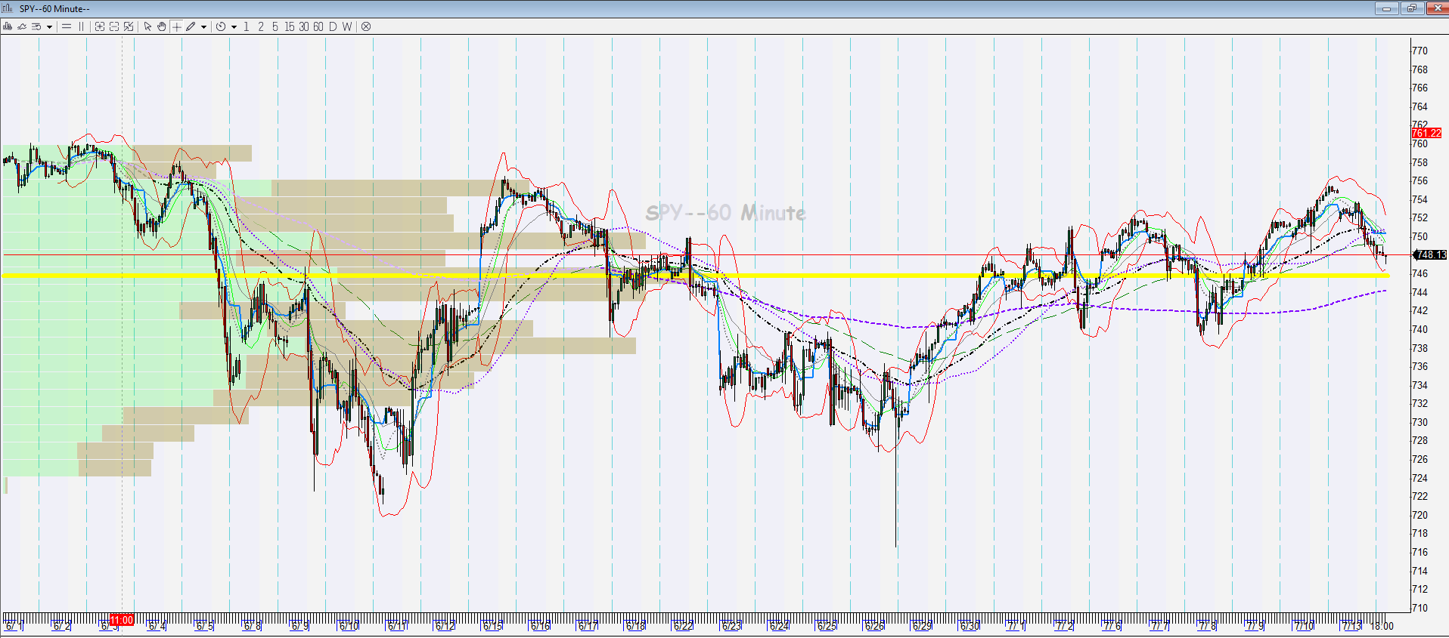
Overview –Acceptance vs Rejection

Slide 13
Introduction to the Camarilla System
Sell
Day High
The Starting Data: The Camarilla formula uses only three inputs from yesterday's session: the High, the Low, and the Close.
Mapping Yesterday's Balance: These three inputs represent the boundary and final consensus of yesterday’s completed auction.
Projecting Today's Boundaries: By mathematically analyzing yesterday's range, the Camarilla algorithm projects exactly where today's auction will become overextended (unfairly high or unfairly low).
Closing Price
Buy
Day Low

Slide 14
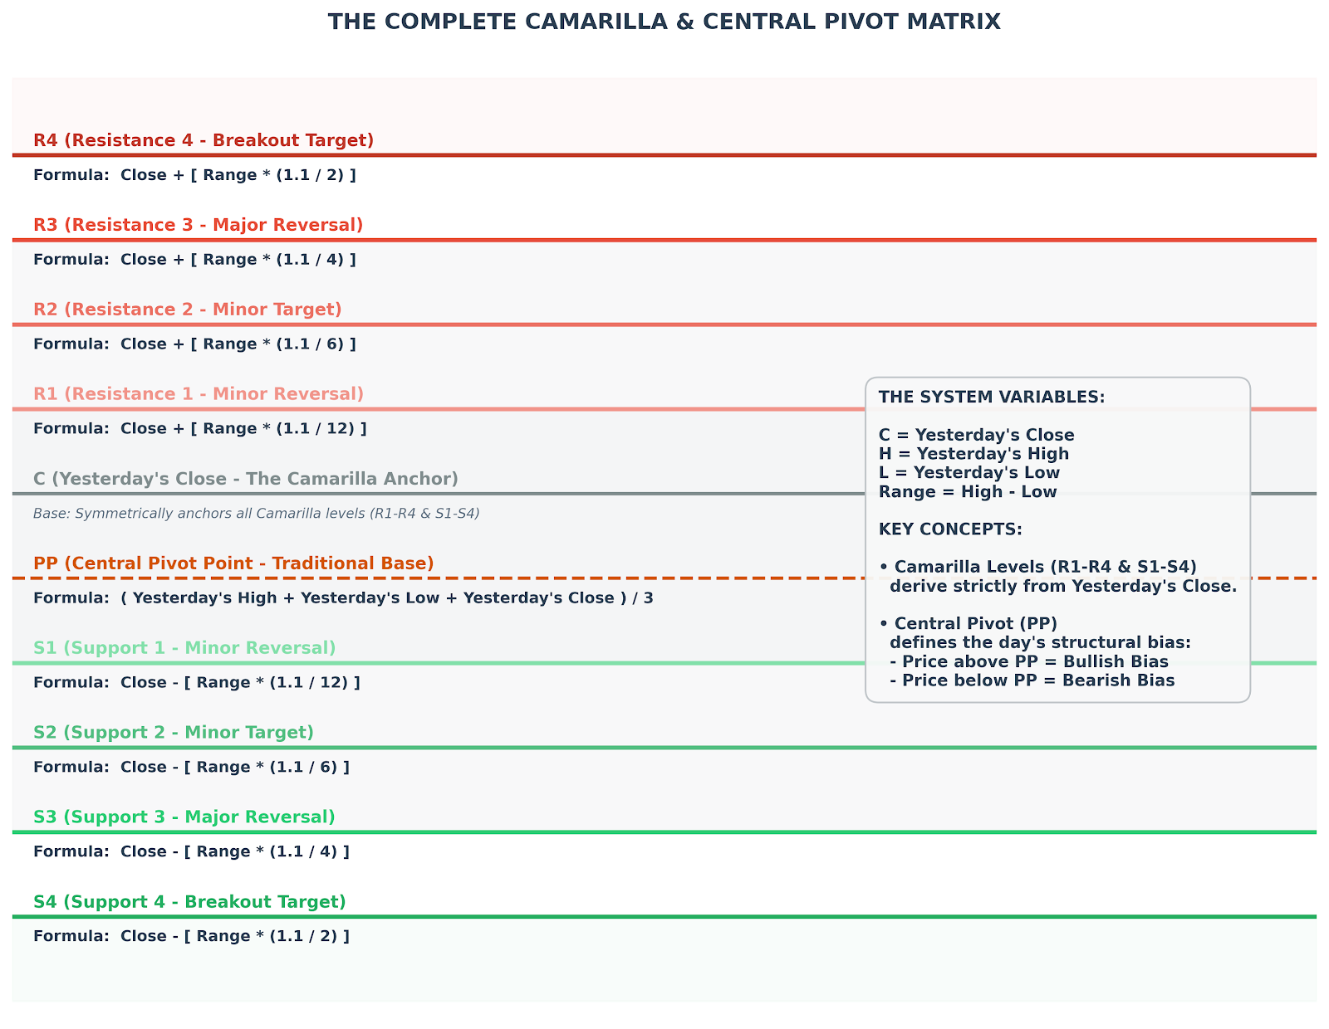
Camarilla Formula

